Slide 1
Certification of Internal Controls Over the Payment Process
Bureau of State Expenditures

Slide 2
Agenda
Criteria Overview
2025 Requirement & Results
2026 Requirement

Slide 3
Criteria Overview
The agency head (e.g., Commissioner, Chancellor, Executive Director) is responsible for agency operations.
Certification or approval of vouchers and expense reports shall be made by the agency head, or by those designated by the agency head.§
Each agency must maintain adequate internal controls over the payment process to support the validity of the agency claim certification.
Head of department or designee must certify to Comptroller that claim is just, true and correct and therefore appropriate to pay.
State Finance Law § 110

Slide 4
Criteria Overview
The agency head must submit an Internal Controls Certification to OSC certifying the agency established proper internal controls over the payment process in accordance with:
    New York Codes, Rules and Regulations Title 2, Chapter I, Part 6.6
    Guide to Financial Operations Section XII.4.D Certification of Internal Controls over the Payment Process
This is required annually or upon change of the agency head.

Slide 5
Evaluating Controls over the Payment Process
Evaluating the controls over the payment process helps ensure agencies routinely evaluate the effectiveness of internal controls.
Helps identify or prevent problems and errors.
Allows the agency to take appropriate action if problems or errors are identified.
Reduces the risk of approving improper payments.
Helps support payments processed to OSC are just, true, correct and appropriate to pay.

Slide 6
Annual Requirements
Scope of audit includes an assessment of:
    Internal controls over the payment process as a whole.
    A segment of the payment process or a focus area.
    Voucher authorizer designation process.
Certification form due by April 30th.
    BSEInternalControlCert@osc.ny.gov
Agencies must complete and retain supporting documentation to support their testing and conclusions and provide it to OSC upon request.

Slide 7
Certification Resources
Guide to Financial Operations (GFO) Section XII.4.D contains:
Requirements for the certifications due annually
Audit programs
Frequently Asked Questions
Email: BSEInternalControlCert@osc.ny.gov

Slide 8
2025 Requirements
Certify internal controls over the:
  Payment process
  Voucher mass approval & bulkload process
  Voucher authorizer designation process

Slide 9
2025 Results
Certifications reported by agencies:
    81% Satisfactory
    19% Satisfactory with weaknesses
Sample agencies for supporting documentation

Slide 10
2026 Requirements
Certify internal controls over the:
    Payment process
    Record retention & SFS attachments
    Voucher authorizer designation process
Certification due by April 30th, 2026.

Slide 11
Record Retention
Confirm the agency:
Has policies and procedures consistent with the New York State Archives’ Record Retention requirements and the Guide to Financial operations (GFO) Section XII.3 – Record Retention and Section XII.6.B – Land Acquisition Payments, if applicable.
Received adequate documentation to support payments in accordance with GFO Section XII.4.B.1 – Supporting Information and confirm goods and services were rendered.
    Including payments pursuant to grant contracts.
Obtained appropriate documentation to support all payments (including Travel & Expense) for time frames consistent with the State Records Retention laws.

Slide 12
SFS Attachments
Confirm the agency:
Has policies and procedures consistent with the GFO Section XIV.9 – Statewide Financial System Imaging and Attachment Guidance.
Has processes for uploading appropriate and accurate documentation to SFS, including when redacting Personal and Private Information (PPI).
Verifies imaged records are accurate, legible and completely reflect all the information in the original documents.

Slide 13
Voucher Authorizers
Determine whether the agency properly filed its voucher authorizers and designees with OSC. This should include:
Assessing the agency’s controls over the voucher authorizer process.
Verifying that vouchers and expense reports were appropriately authorized.
Completing Attachment A of the Internal Controls over the Payment Process form annually and including the title of any designees with the filing.

Slide 14
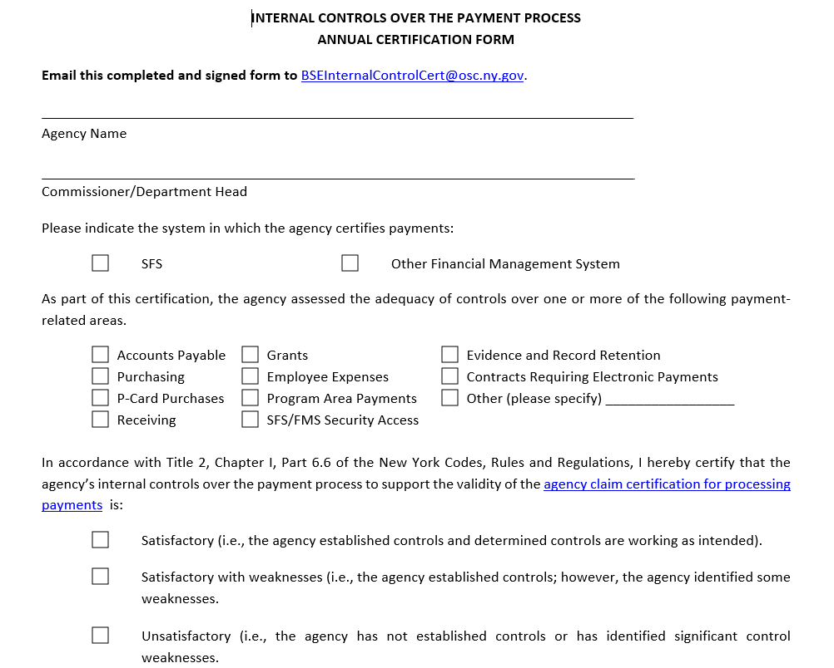

Slide 15
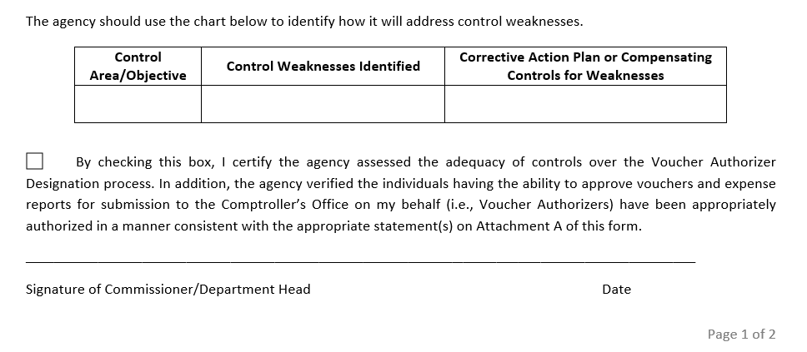

Slide 16
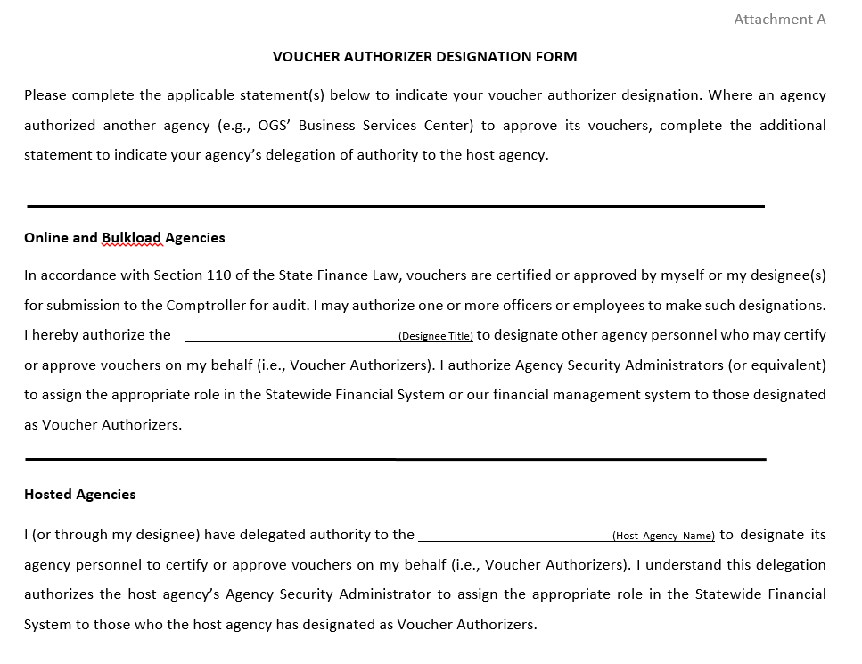

Slide 18
Best Practices
One certification form per SFS Business Unit.
Audit documentation should include:
    Methodology to support sample size and testing.
    Summary of testing results.
    Recommendations.
    Corrective action plan:
        Identifies internal controls and weaknesses
        Assesses risks and includes the related steps to address them
        Documents implementation and monitoring steps, dates, etc.

Slide 19
2027 Requirements
Certify internal controls over the:
  Payment process
  Invoice review and voucher certification process
  Voucher authorizer designation process
Certification due by April 30th, 2027.

Slide 20
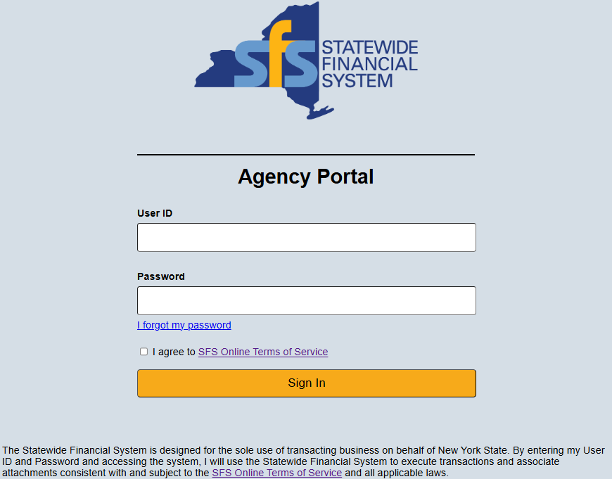
Agency Certification
SFS Terms of Service

Slide 21
Agency Certification
SFS Terms of Service
Agency user is:
    Authorized to execute transactions within SFS
    Familiar, and will use SFS in accordance with the Ethics in Government Act
    Familiar, and will use SFS in accordance with OSC’s policies on confidential, personal, and private information

Slide 22
Agency Certification
SFS Terms of Service
Vouchers approved by agency reviewers and sent to OSC are just, true, correct, and appropriate to pay.
Expense reports processed to OSC are just, true, correct, and appropriate to pay.
Goods or services rendered or furnished are for use in the performance of the official functions and duties of the agency.

Slide 23
Voucher Certification
Prior to certifying any voucher, the agency must complete necessary control activities and the Voucher Authorizer should ensure:
    The agency has acceptable evidence of receipt.
    An agency representative can readily explain how the agency determined the invoice is appropriate.
    An agency representative has reviewed (or someone within the agency has reviewed) the evidence and deems it sufficient to approve for payment.

Slide 24
Voucher Certification
Upon voucher approval, the Voucher Authorizer is certifying that:
    The payment is approved,
    Information entered is just, true and correct, and
    Goods or services rendered or furnished are for use in the performance of the official functions and duties of the agency.

Slide 25
Q
A
&

Slide 26
Contact Us
BSEInternalControlCert@osc.ny.gov

